Slide 1


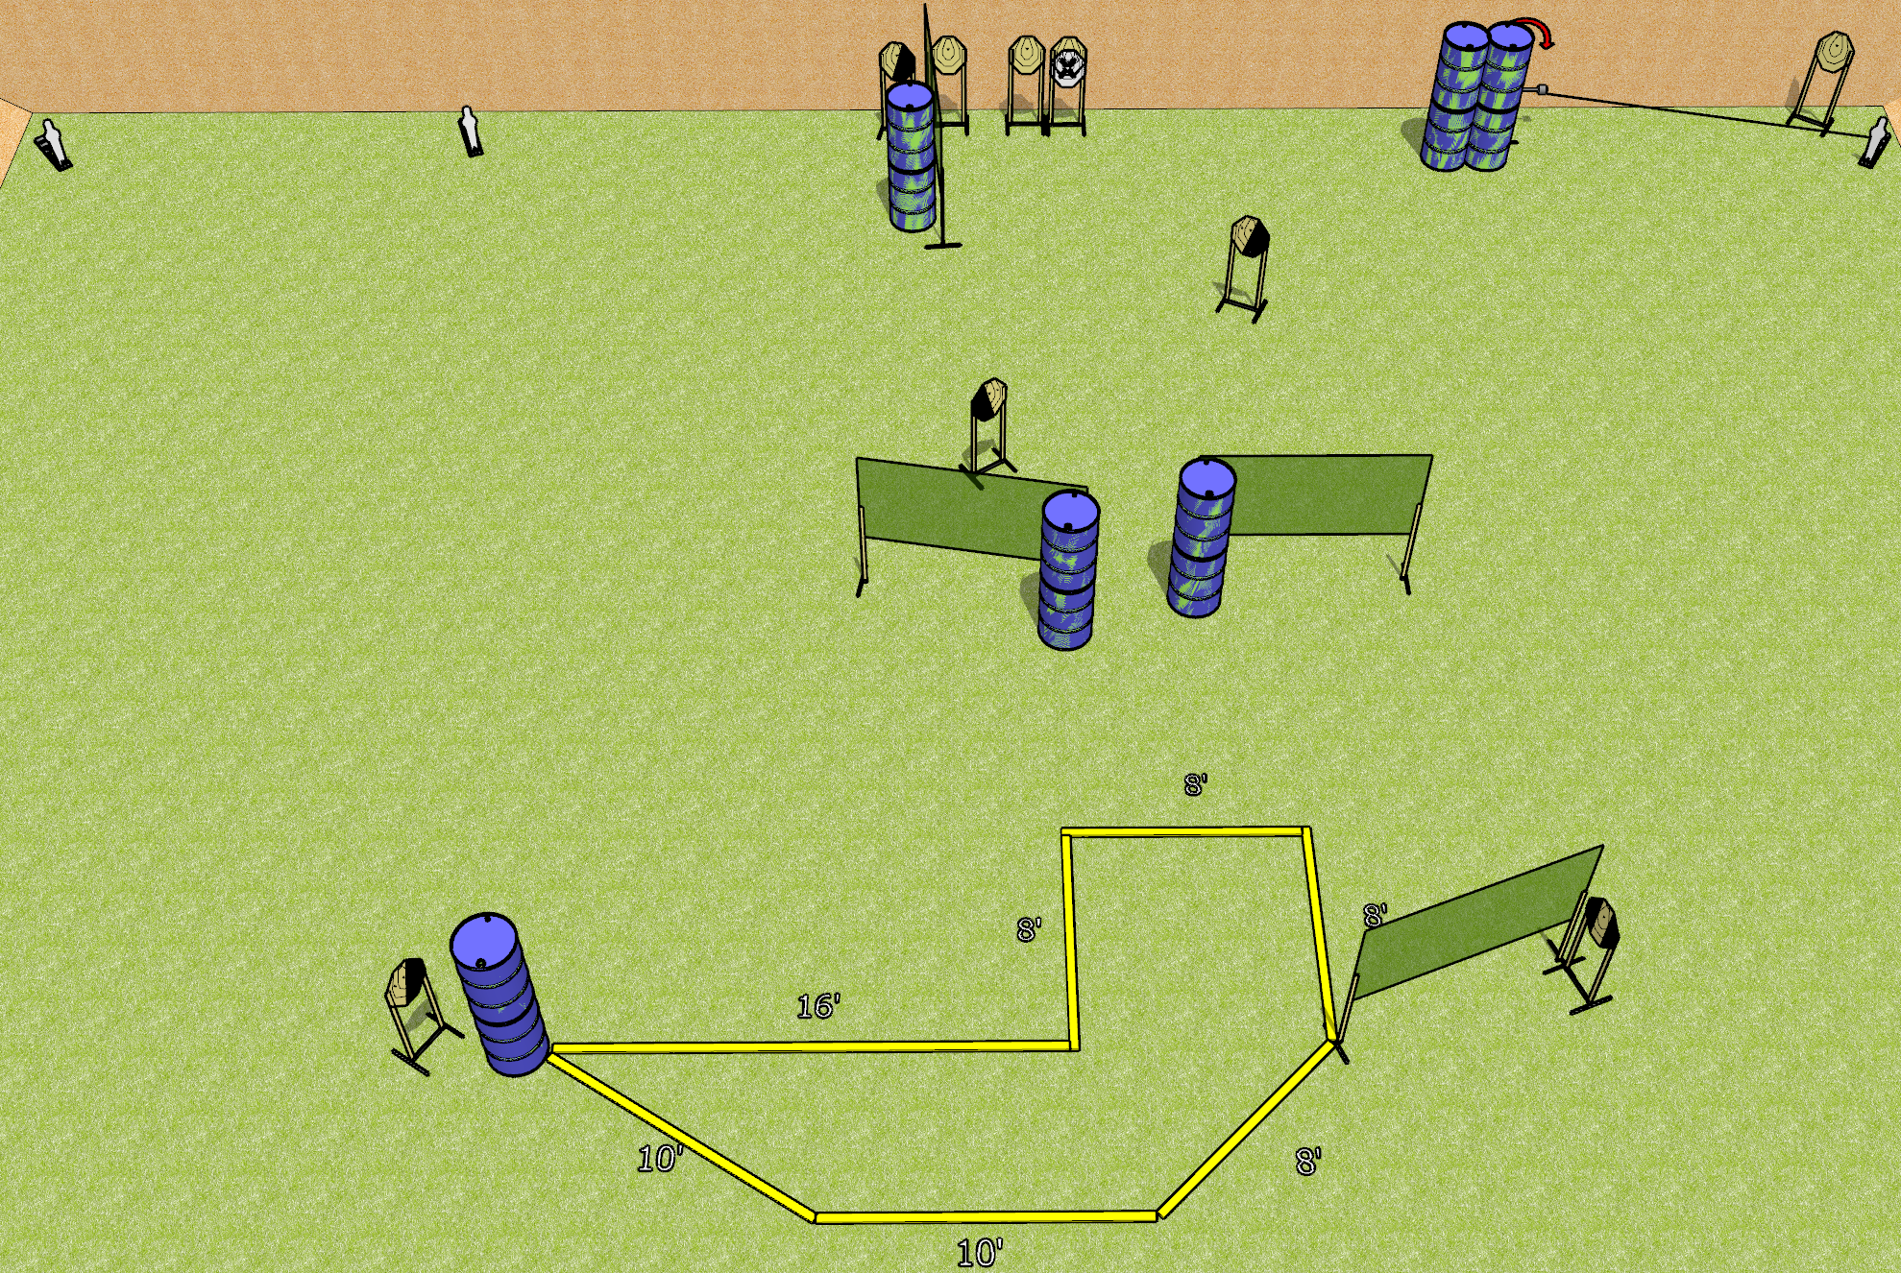
 | Dothan Gun Club – USPSA Match Shuffle Course Designer : Drew Coleman
Round Count 23 rounds 10 IPSC 3 mini poppers
Equipment List 8 wall feet Swinger + activator 1 left diag and 3 right diag, 1 tux

Slide 2
Shuffle
Written Stage Briefing
Shuffle is a 23 round, 115 point Comstock course of fire. There are 10 IPSC targets and 3 mini poppers. The best 2 hits on paper will score, and steel must fall to score. The start signal is audible.
The swinger is activated by the right mini popper and remains visible at rest.
Handgun start position toes of both feet touching rearmost fault line, completely outside shooting area, wrists below belt. Handgun is loaded and holstered.
PCC start position is toes of both feet touching rearmost fault line, completely outside shooting area, stock on belt. Carbine is loaded, safety on.
On start signal engage targets as they become available from within the shooting area.

